Slide 1
National Network For Equitable Library Service
Leslie Corbay
Library Accessibility Consultant
Public Library Services Branch
1

Slide 2
What is NNELS?
Inter-provincial collaboration with a local public library-focused service model to provide services to people with print disabilities
7 participating provinces and territories
British Columbia Saskatchewan Nunavut | Alberta Manitoba Nova Scotia
The Northwest Territories Newfoundland and Labrador

Slide 3
Your Library
& Your Users
NNELS Network
Collections
Authentication
Media & Devices
Media Migration

Slide 4
MaryAnn Kempthorn with a community partner in British Columbia demonstrating NNELS

Slide 5
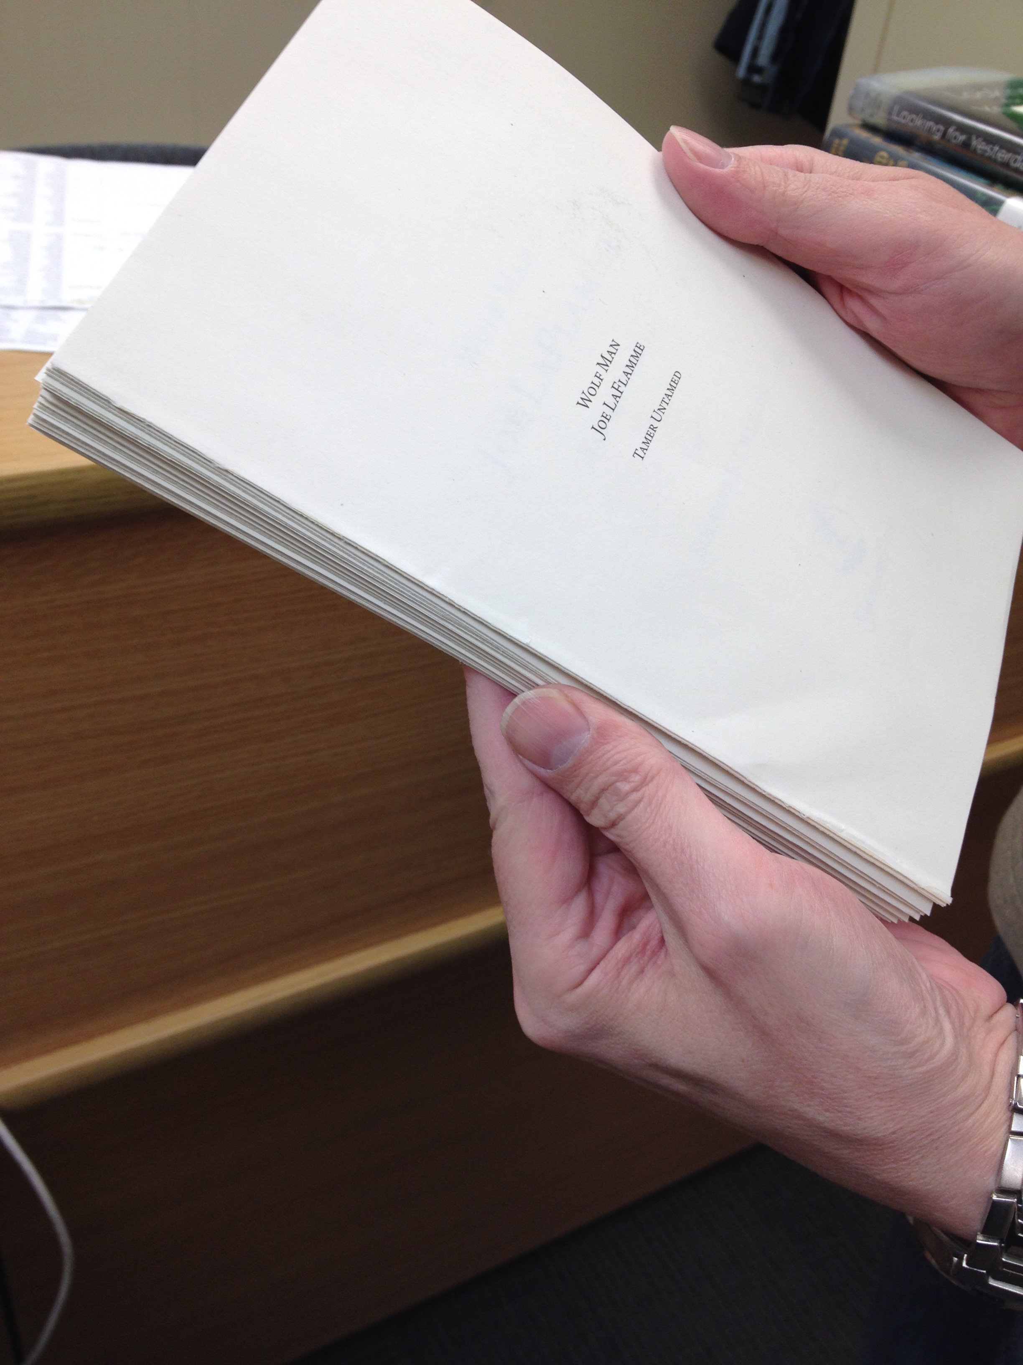
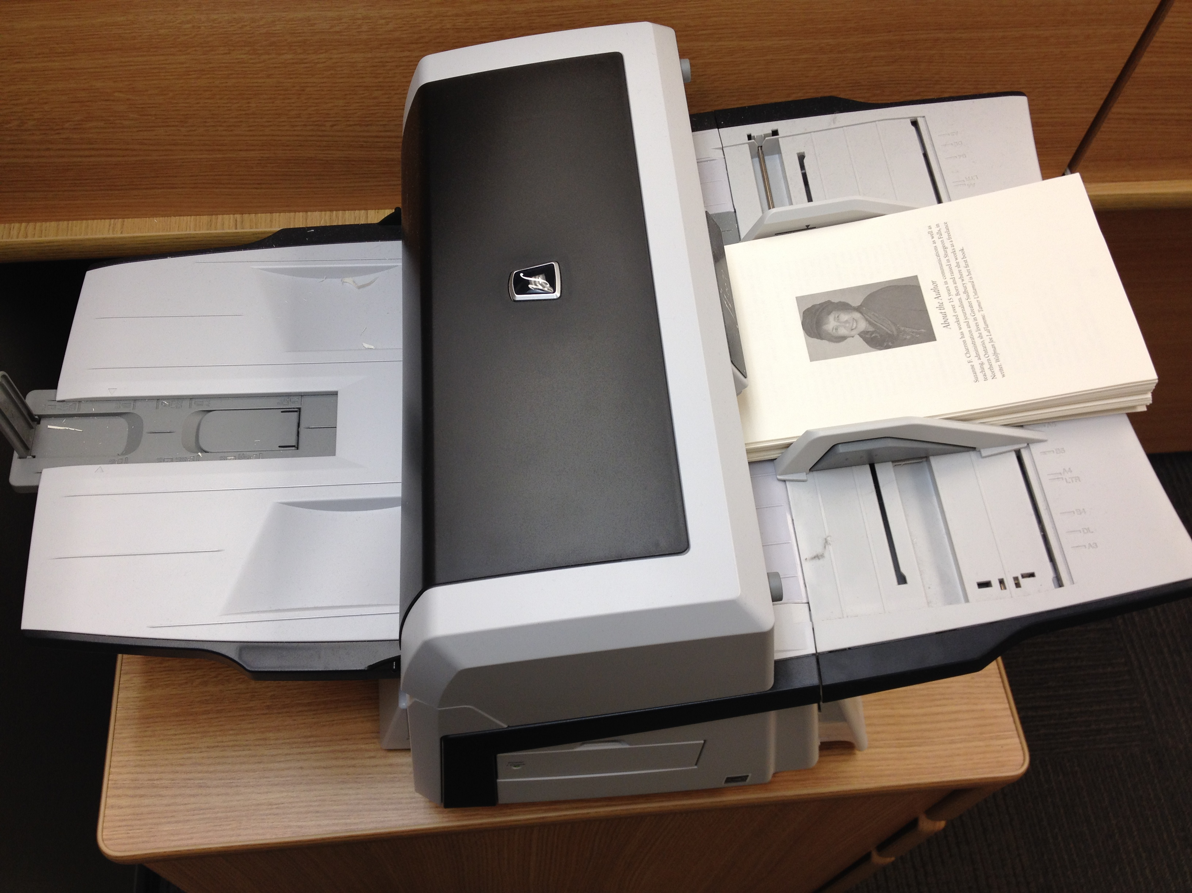
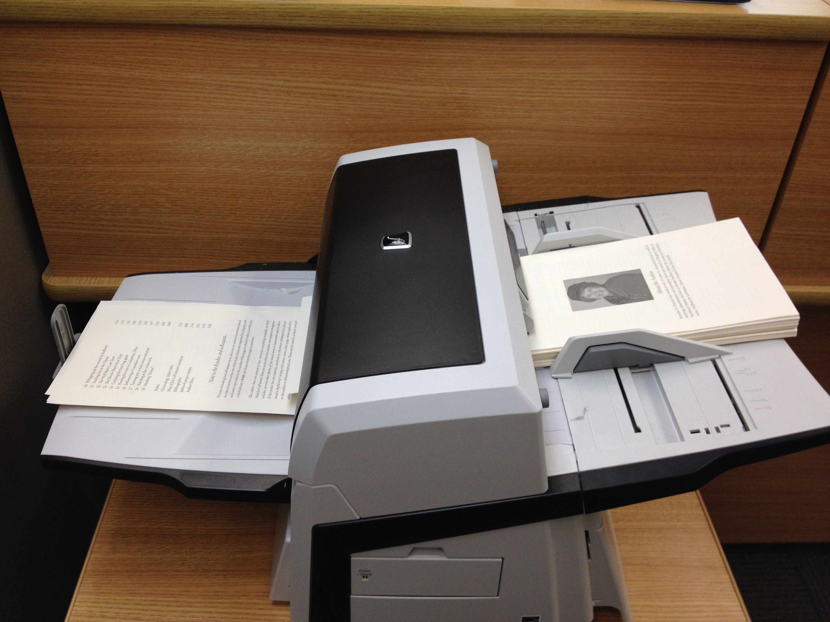
Step 1: Remove spine and cover
Step 2: Place in scanner
Digitization here in Manitoba!
Step 3: Scan!

Slide 6
Digitization of Rare & Out of Print Material
A non-destructive Scanner

Slide 7
Who is NNELS?
Print disabled patrons reading and requesting materials
Public Libraries providing patrons local access to the collection
Provinces funding the project and participating in the network
BC Libraries Co-operative (BCLC) providing the affordable and sustainable repository software

Slide 8
What is a print disability?
severe or total impairment of sight or the inability to focus or move one’s eyes;
inability to hold or manipulate a book;
reading impairment relating to comprehension e.g. dyslexia.

Slide 9
Promoting NNELS
Outreach Services
Connect with local organizations
Make connections with schools
9

Slide 10
Collections
USB key with NNELS content

Slide 11
What does NNELS offer?
10,000 titles DAISY, Mp3 and eBraille
90% Popular Fiction
10% Non-Fiction
85% Adult Content
6% YA
9% children's

Slide 12
What do you need to know?
To help a new NNELS user you need to know two things:
Does the patron have a print disability? What type?
What devices do they use -- or want to use?
12

Slide 13
HOW DO PEOPLE USE NNELS CONTENT?
Download on devices like:
iPad
iPhone
Android device
Victor Readers
Mp3 Player
13

Slide 14
Technical Discussion Area
https://nnels.ca/community-forums/technical-discussion
14

Slide 15
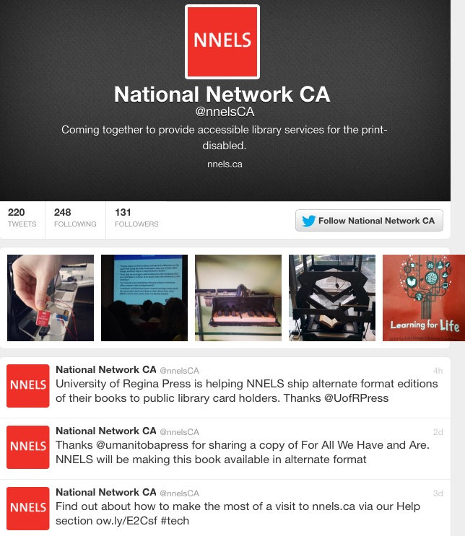
15

Slide 16
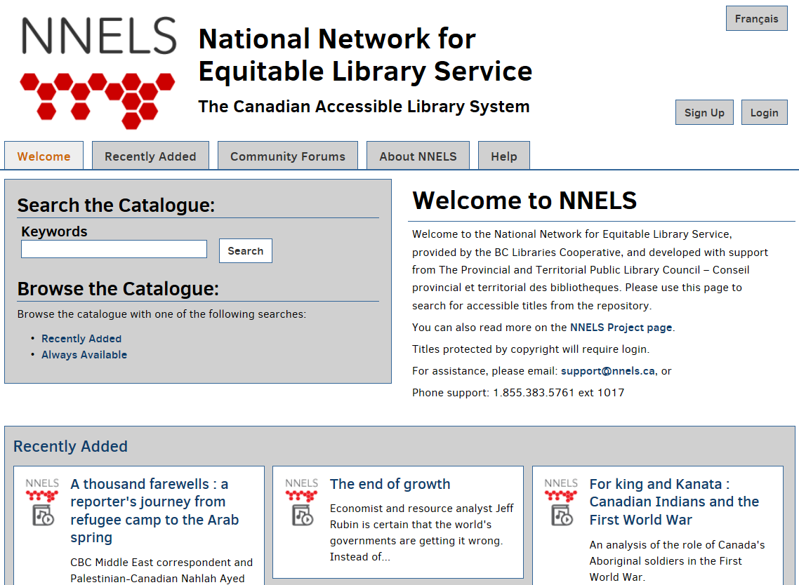
16

Slide 17
What do you need to do?
To help the NNELS service grow, you can:
Use a patron type that allows print-disabled patrons to have direct access to NNELS with their library card
Forward requests for new material to NNELS.ca so that we can produce and share it
Stay in touch. NNELS can only grow with many points of access all across the country. Reach NNELS at anytime at support@nnels.ca

Slide 18
Staff engagement. Community engagement. Media shift. Print producers. Advanced discovery

Slide 19
www.nnels.ca
19

